Slide 1
System of linear equations-II

Slide 2
Recall: Gauss-Jordan Elimination
The Gauss-Jordan elimination method is a technique for solving systems of linear equations of any size.
The operations of the Gauss-Jordan method are
Interchange any two equations.
Replace an equation by a nonzero constant multiple of itself.
Replace an equation by the sum of that equation and a constant multiple of any other equation.

Slide 3
Recall: Row-Reduced Form of a Matrix
Each row consisting entirely of zeros lies below all rows having nonzero entries.
The first nonzero entry in each nonzero row is 1 (called a leading/pivot 1).
In any two successive (nonzero) rows, the leading 1 in the lower row lies to the right of the leading 1 in the upper row.
If a column contains a leading 1, then the other entries in that column are zeros.
Row Operations
Interchange any two rows.
Replace any row by a nonzero constant multiple of itself.
Replace any row by the sum of that row and a constant multiple of any other row.

Slide 4
Recall: The Gauss-Jordan Elimination Method
Write the augmented matrix corresponding to the linear system.
Interchange rows, if necessary, to obtain an augmented matrix in which the first entry in the first row is nonzero. Then pivot the matrix about this entry.
Interchange the second row with any row below it, if necessary, to obtain an augmented matrix in which the second entry in the second row is nonzero. Pivot the matrix about this entry.
Continue until the final matrix is in row-reduced form.

Slide 5
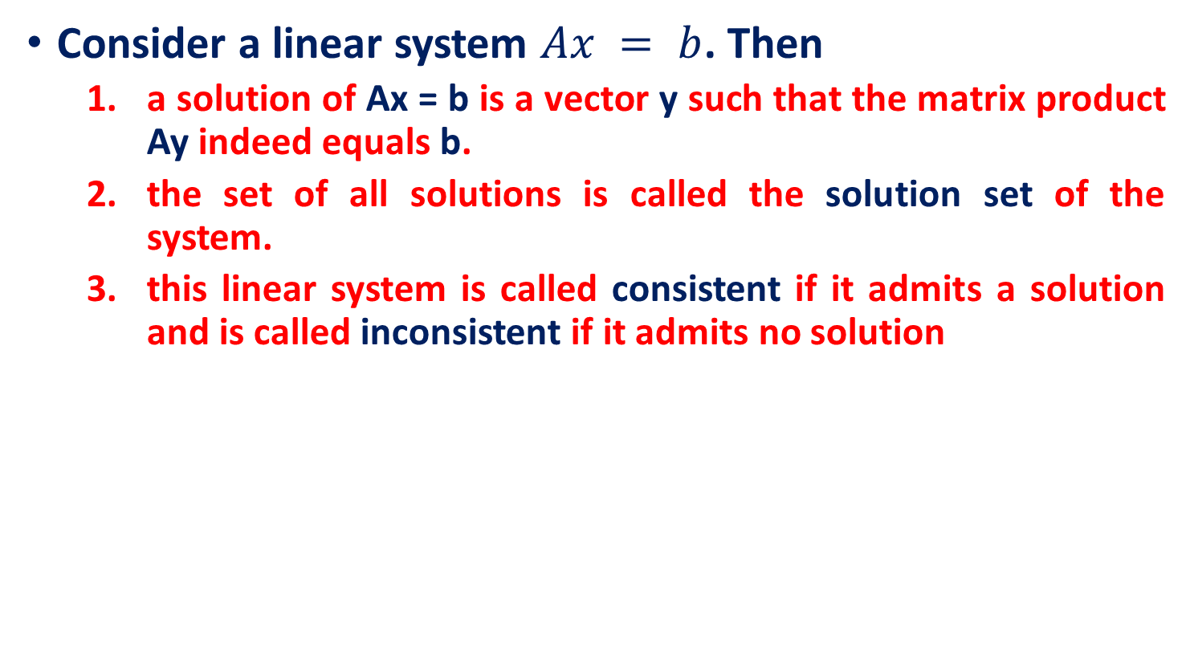
Recall: System of linear equations
Consider a linear system $Ax = b$. Then
a solution of Ax = b is a vector y such that the matrix product Ay indeed equals b.
the set of all solutions is called the solution set of the system.
this linear system is called consistent if it admits a solution and is called inconsistent if it admits no solution

Slide 6
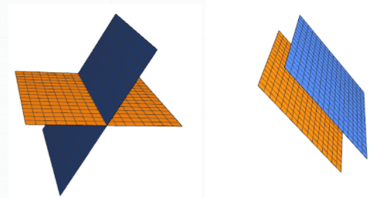
Recall: System of linear equations
Underdetermined if n>m: “more unknowns than equations”
cannot have a unique solution.
In this case, there are either infinitely many or no solutions.
For an example of this, refer to what can happen with only two planes in three dimensions:
Overdetermined if m>n: “more equations than unknowns”
An overdetermined system may also have infinitely many or no solutions or may have a unique solution

Slide 7



System of linear equations
Theorem. If there is a row in an augmented matrix containing all zeros to the left of the vertical line and a nonzero entry to the right of the line, then the corresponding system of equations has no solution.
$$x_{1}+x_{2}+x_{3}=1$$
$${3x}_{1}−x_{2}−x_{3}=4$$
$$x_{1}+{5x}_{2}+5x_{3}=−1$$
$$\left[\begin{matrix}1 & 1 & 1 & 1 \\ 3 & −1 & −1 & 4 \\ 1 & 5 & 5 & −1\end{matrix}\right]$$
$$\left[\begin{matrix}1 & 1 & 1 & 1 \\ 0 & −4 & −4 & 1 \\ 0 & 0 & 0 & −1\end{matrix}\right]$$
inconsistent

Slide 8
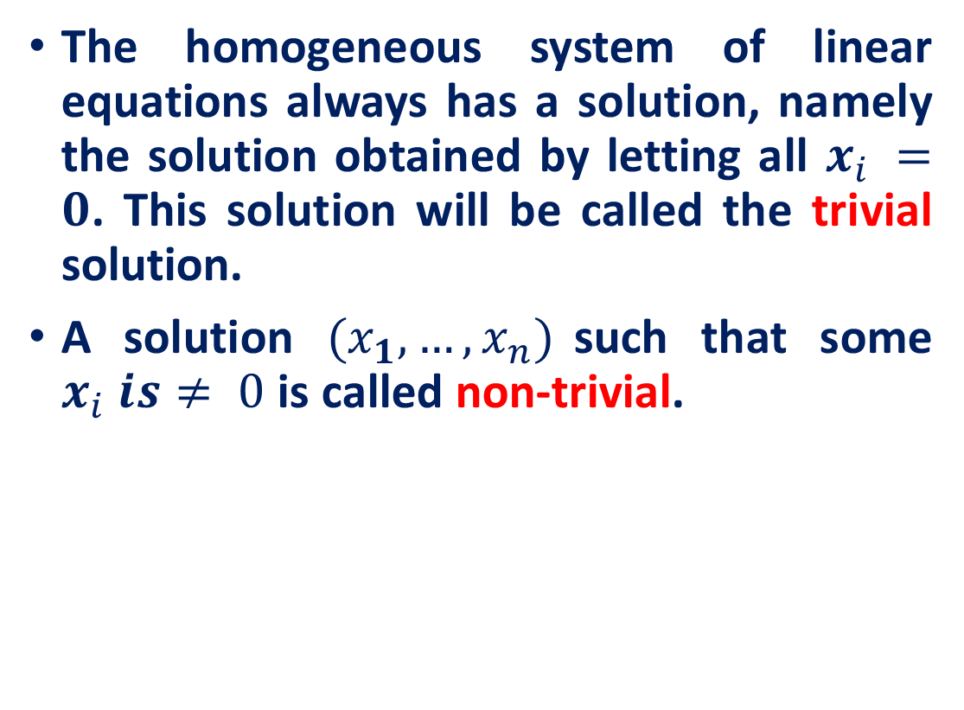
Homogenous system of linear equations
The homogeneous system of linear equations always has a solution, namely the solution obtained by letting all $x_{i} =0$. This solution will be called the trivial solution.
A solution $(x_{1}, …,x_{n})$such that some $x_{i} is≠ 0$is called non-trivial.

Slide 9
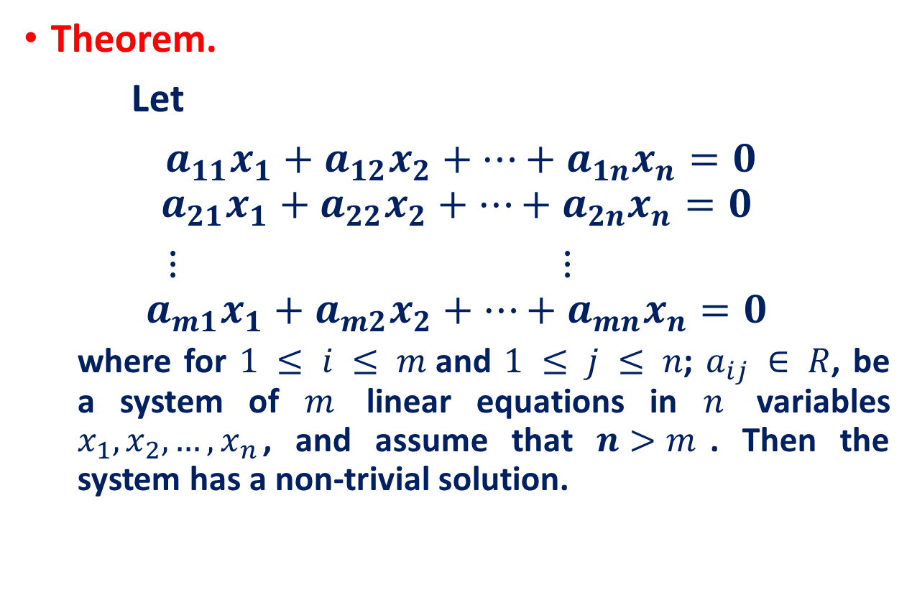
Homogenous system of linear equations
Theorem.
Let
$a_{11}x_{1}+a_{12}x_{2}+…+a_{1n}x_{n}=0$
$$a_{21}x_{1}+a_{22}x_{2}+…+a_{2n}x_{n}=0$$
$⋮$ $⋮$
$$a_{m1}x_{1}+a_{m2}x_{2}+…+a_{mn}x_{n}=0$$
where for $1 ≤ i ≤ m$and $1 ≤ j ≤ n$; $a_{ij} ∈ R$, be a system of $m$ linear equations in $n$ variables $x_{1}, x_{2}, …, x_{n}$, and assume that $n>m$. Then the system has a non-trivial solution.

Slide 10
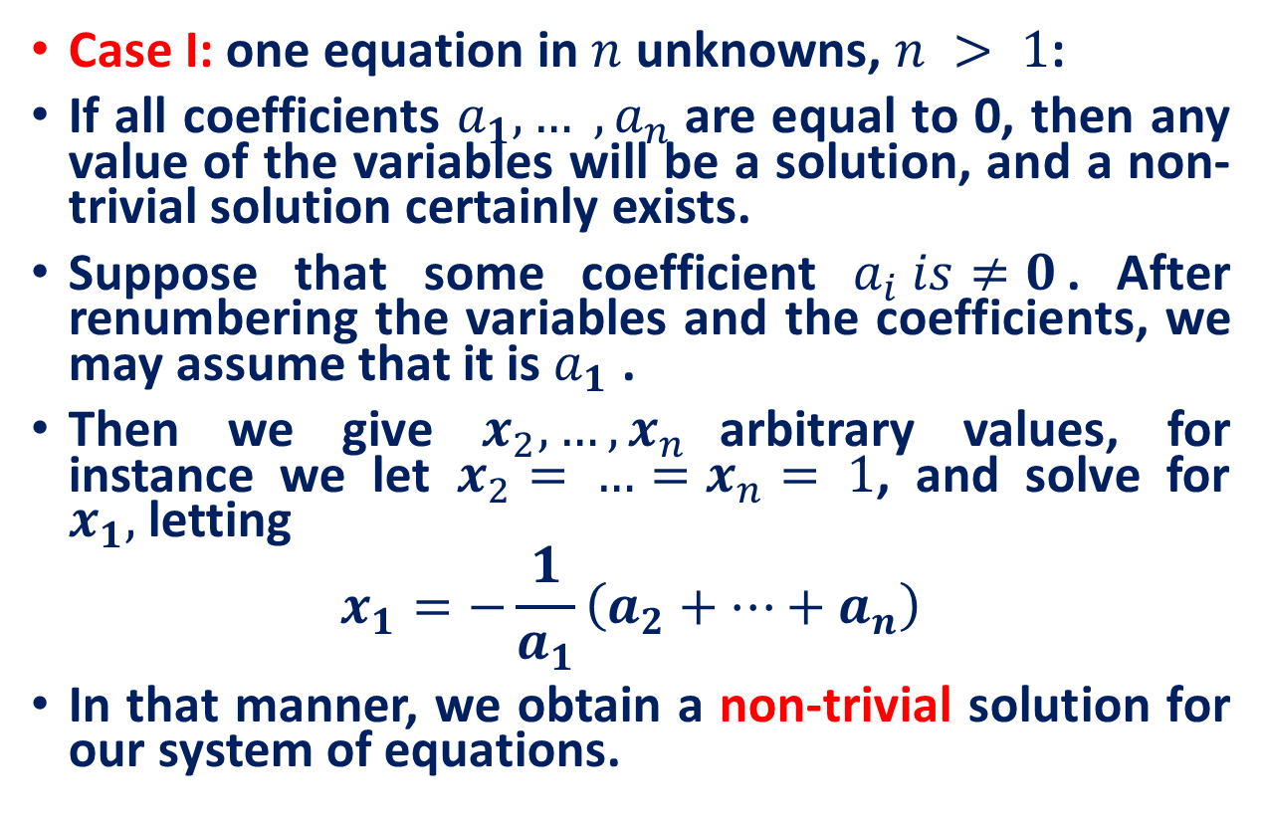
Homogenous system of linear equations
Case I: one equation in $n$ unknowns, $n > 1$:
If all coefficients $a_{1}, … ,a_{n}$are equal to 0, then any value of the variables will be a solution, and a non-trivial solution certainly exists.
Suppose that some coefficient $a_{i} is≠0$. After renumbering the variables and the coefficients, we may assume that it is $a_{1}$ .
Then we give $x_{2}, …, x_{n}$arbitrary values, for instance we let $x_{2}= …=x_{n}= 1$, and solve for $x_{1},$ letting
$$x_{1}=−\frac{1}{a_{1}}\left(a_{2}+…+a_{n}\right)$$
In that manner, we obtain a non-trivial solution for our system of equations.

Slide 11
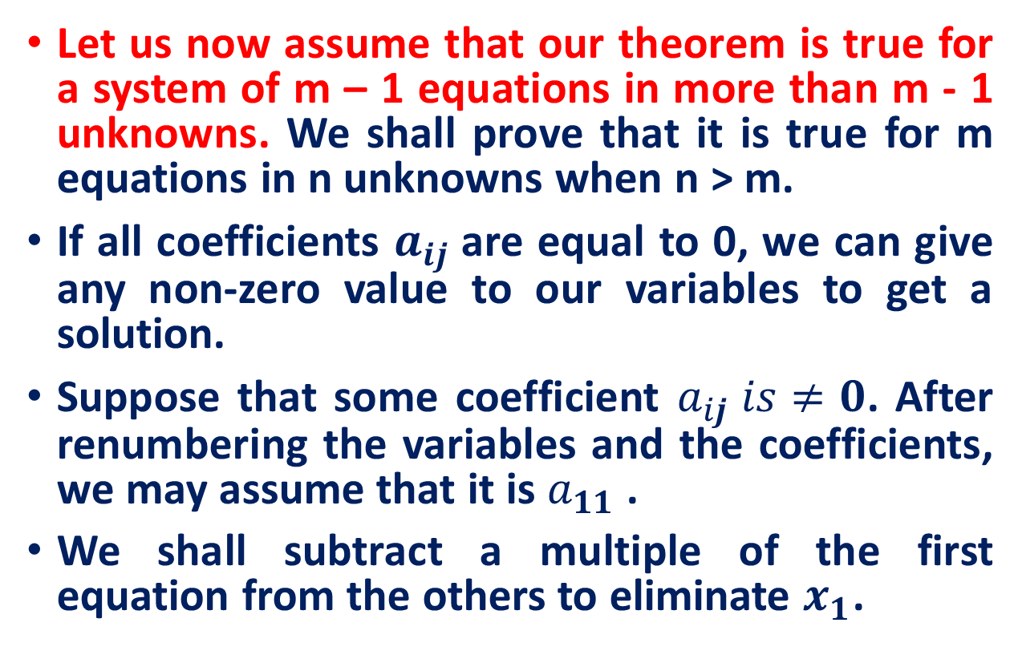
Homogenous system of linear equations
Let us now assume that our theorem is true for a system of m – 1 equations in more than m - 1 unknowns. We shall prove that it is true for m equations in n unknowns when n > m.
If all coefficients $a_{ij}$are equal to 0, we can give any non-zero value to our variables to get a solution.
Suppose that some coefficient $a_{ij} is≠0$. After renumbering the variables and the coefficients, we may assume that it is $a_{11}$ .
We shall subtract a multiple of the first equation from the others to eliminate $x_{1}$.

Slide 12
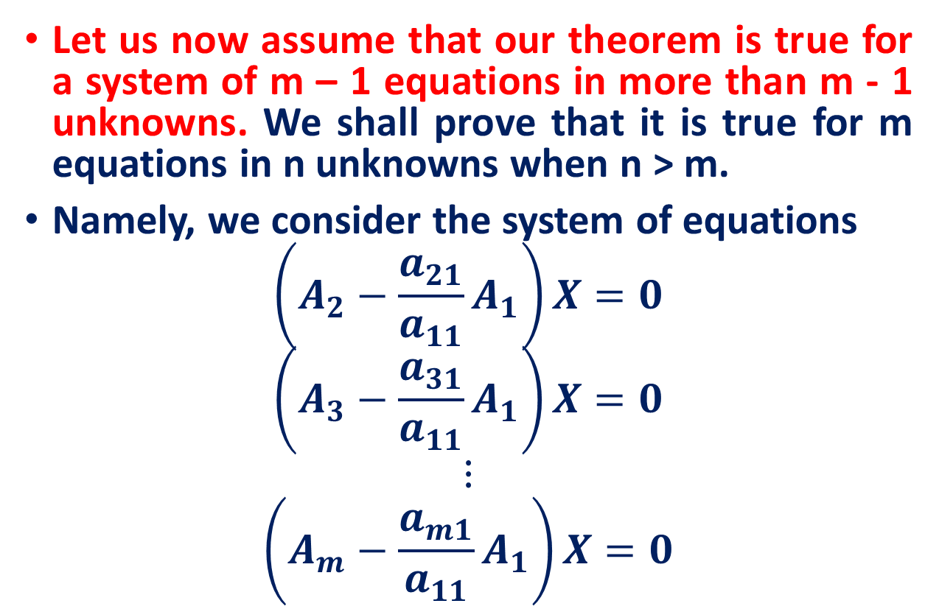
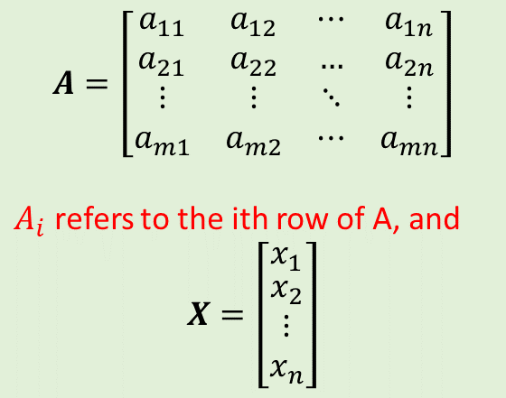
Homogenous system of linear equations
Let us now assume that our theorem is true for a system of m – 1 equations in more than m - 1 unknowns. We shall prove that it is true for m equations in n unknowns when n > m.
Namely, we consider the system of equations
$$\left(A_{2}−\frac{a_{21}}{a_{11}}A_{1}\right)X=0$$
$$\left(A_{3}−\frac{a_{31}}{a_{11}}A_{1}\right)X=0$$
$$⋮$$
$$\left(A_{m}−\frac{a_{m1}}{a_{11}}A_{1}\right)X=0$$
$$A=\left[\begin{matrix}a_{11} & a_{12} & ⋯ & a_{1n} \\ a_{21} & a_{22} & … & a_{2n} \\ ⋮ & ⋮ & ⋱ & ⋮ \\ a_{m1} & a_{m2} & ⋯ & a_{mn}\end{matrix}\right]$$
$A_{i}$ refers to the ith row of A, and
$$X=\left[\begin{matrix}x_{1} \\ \begin{aligned}x_{2} \\ ⋮ \\ x_{n}\end{aligned}\end{matrix}\right]$$

Slide 13
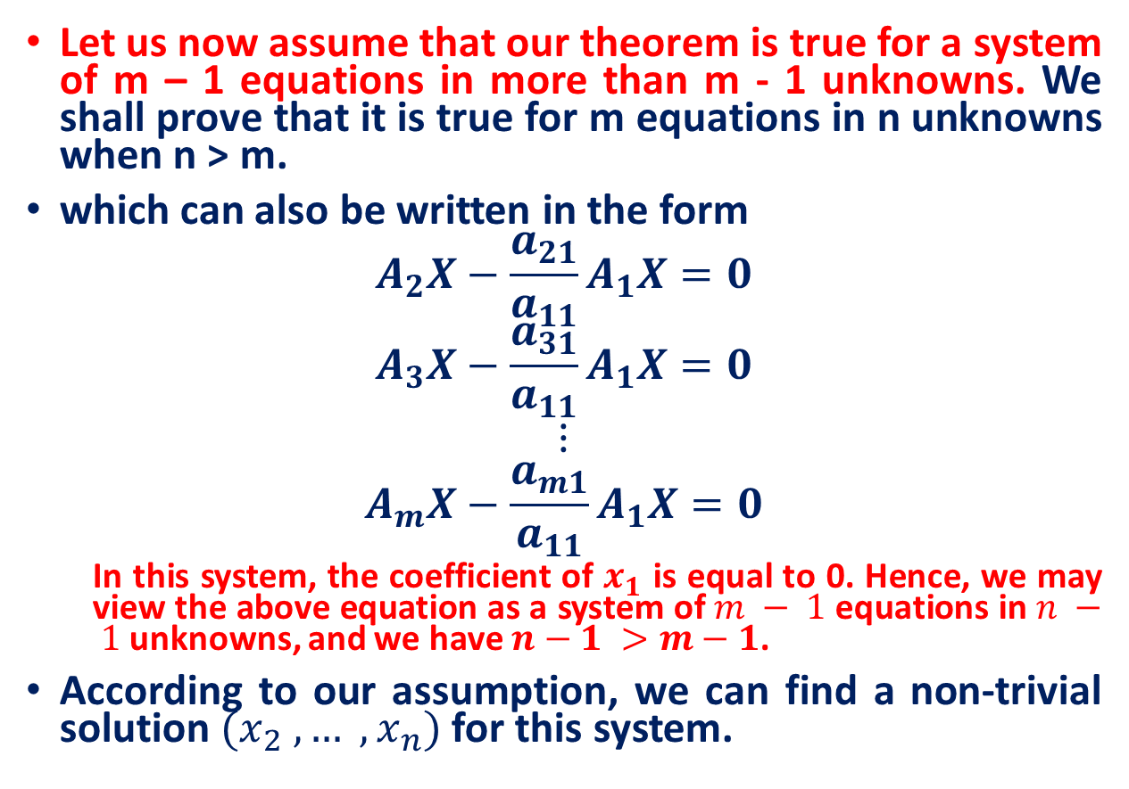
Homogenous system of linear equations
Let us now assume that our theorem is true for a system of m – 1 equations in more than m - 1 unknowns. We shall prove that it is true for m equations in n unknowns when n > m.
which can also be written in the form
$$A_{2}X−\frac{a_{21}}{a_{11}}A_{1}X=0$$
$$A_{3}X−\frac{a_{31}}{a_{11}}A_{1}X=0$$
$$⋮$$
$$A_{m}X−\frac{a_{m1}}{a_{11}}A_{1}X=0$$
In this system, the coefficient of $x_{1}$ is equal to 0. Hence, we may view the above equation as a system of $m − 1$equations in $n − 1$unknowns, and we have $n−1 >m−1$.
According to our assumption, we can find a non-trivial solution $(x_{2} , … ,x_{n})$for this system.
$$A=\left[\begin{matrix}a_{11} & a_{12} & ⋯ & a_{1n} \\ a_{21} & a_{22} & … & a_{2n} \\ ⋮ & ⋮ & ⋱ & ⋮ \\ a_{m1} & a_{m2} & ⋯ & a_{mn}\end{matrix}\right]$$
$A_{i}$ refers to the ith row of A, and
$$X=\left[\begin{matrix}x_{1} \\ \begin{aligned}x_{2} \\ ⋮ \\ x_{n}\end{aligned}\end{matrix}\right]$$

Slide 14
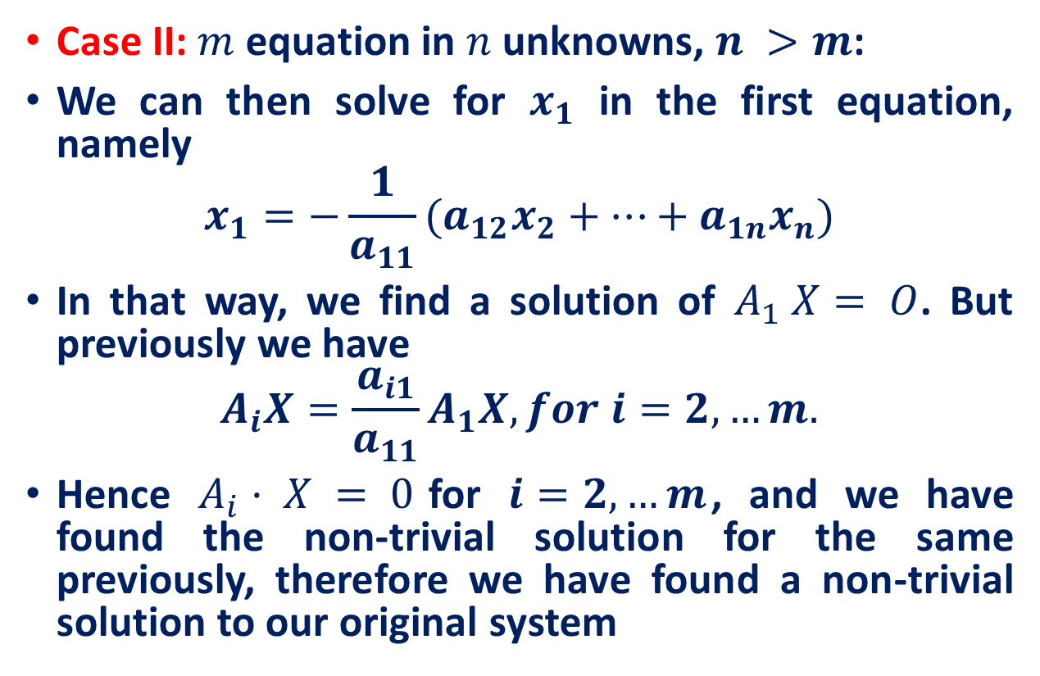
Homogenous system of linear equations
Case II: $m$ equation in $n$ unknowns, $n >m$:
We can then solve for $x_{1}$ in the first equation, namely
$$x_{1}=−\frac{1}{a_{11}}(a_{12}x_{2}+…+a_{1n}x_{n})$$
In that way, we find a solution of $A_{1} X= O$. But previously we have
$$A_{i}X=\frac{a_{i1}}{a_{11}}A_{1}X, for i=2,…m.$$
Hence $A_{i}· X = 0$for $i=2,…m$, and we have found the non-trivial solution for the same previously, therefore we have found a non-trivial solution to our original system
$$A=\left[\begin{matrix}a_{11} & a_{12} & ⋯ & a_{1n} \\ a_{21} & a_{22} & … & a_{2n} \\ ⋮ & ⋮ & ⋱ & ⋮ \\ a_{m1} & a_{m2} & ⋯ & a_{mn}\end{matrix}\right]$$
$A_{i}$ refers to the ith row of A, and
$$X=\left[\begin{matrix}x_{1} \\ \begin{aligned}x_{2} \\ ⋮ \\ x_{n}\end{aligned}\end{matrix}\right]$$

Slide 15

Homogenous system of linear equations
Use Gaussian elimination to solve the following homogeneous system of equations.
$$x_{1}−x_{2}−x_{3}+3x_{4}=0$$
$$x_{1}+x_{2}−{2x}_{3}+x_{4}=0$$
$${4x}_{1}−{2x}_{2}+4x_{3}+x_{4}=0$$
Source: https://portal.tpu.ru/SHARED/k/KONVAL/Sites/English_sites/M/s_HomoE.htm

Slide 16

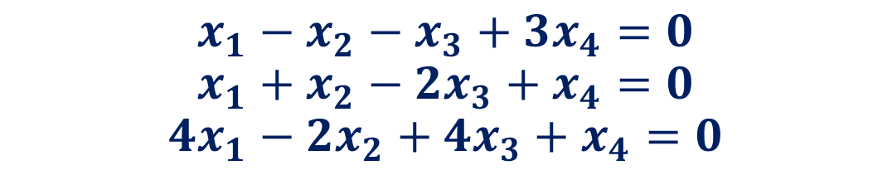
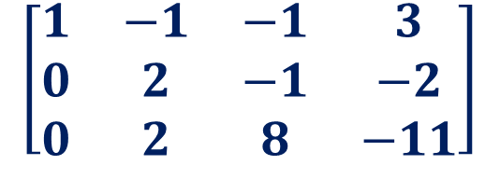
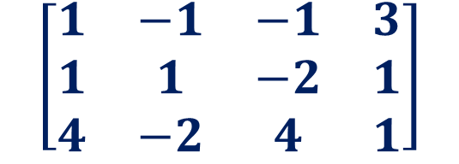
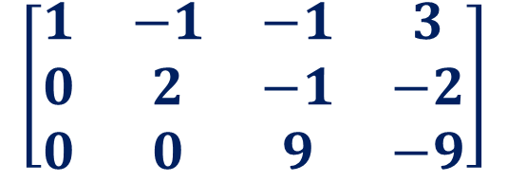

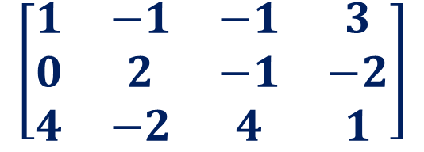

Homogenous system of linear equations: non-trivial Solution
$$x_{1}−x_{2}−x_{3}+3x_{4}=0$$
$$x_{1}+x_{2}−{2x}_{3}+x_{4}=0$$
$${4x}_{1}−{2x}_{2}+4x_{3}+x_{4}=0$$
$$\left[\begin{matrix}1 & −1 & −1 & 3 \\ 1 & 1 & −2 & 1 \\ 4 & −2 & 4 & 1\end{matrix}\right]$$
$$\left[\begin{matrix}1 & −1 & −1 & 3 \\ 0 & 2 & −1 & −2 \\ 4 & −2 & 4 & 1\end{matrix}\right]$$
$$R_{2}←R_{2}−R_{1}$$
$$R_{3}←R_{3}−{4R}_{1}$$
$$\left[\begin{matrix}1 & −1 & −1 & 3 \\ 0 & 2 & −1 & −2 \\ 0 & 0 & 9 & −9\end{matrix}\right]$$
$$\left[\begin{matrix}1 & −1 & −1 & 3 \\ 0 & 2 & −1 & −2 \\ 0 & 2 & 8 & −11\end{matrix}\right]$$
$$R_{3}←R_{3}−R_{2}$$

Slide 17
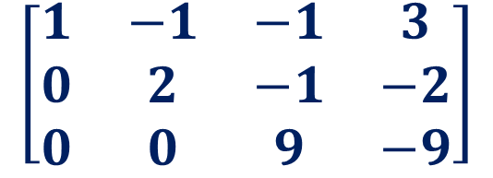
Homogenous system of linear equations: non-trivial Solution
$$x_{1}−x_{2}−x_{3}+3x_{4}=0$$
$$x_{1}+x_{2}−{2x}_{3}+x_{4}=0$$
$${4x}_{1}−{2x}_{2}+4x_{3}+x_{4}=0$$
$$\left[\begin{matrix}1 & −1 & −1 & 3 \\ 0 & 2 & −1 & −2 \\ 0 & 0 & 9 & −9\end{matrix}\right]$$
The rank of this matrix equals 3, and so the system with four unknowns has an infinite number of solutions, depending on one free variable.

Slide 18
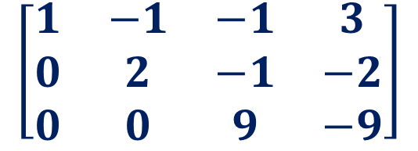
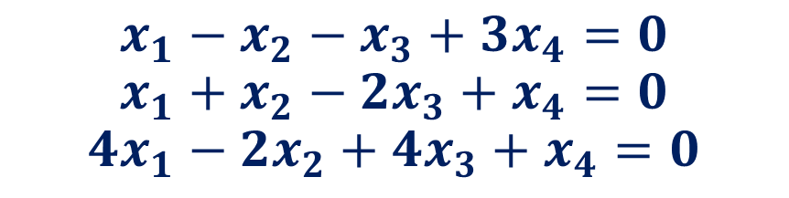
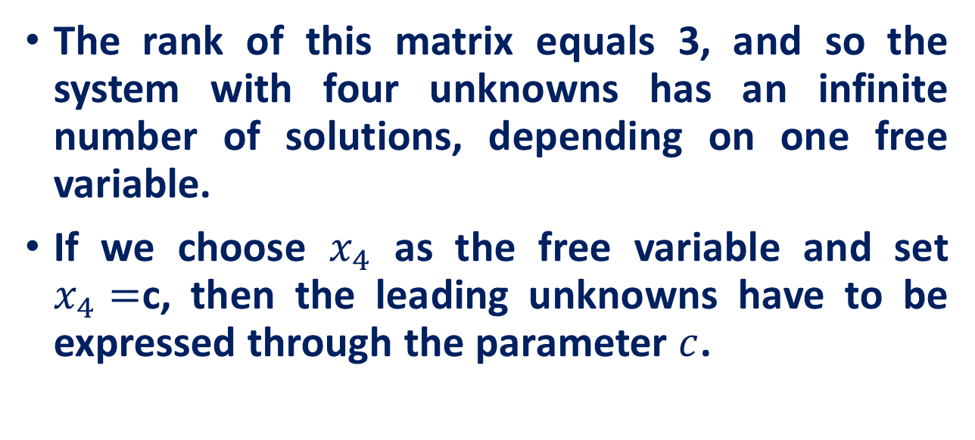
Homogenous system of linear equations: non-trivial Solution
$$x_{1}−x_{2}−x_{3}+3x_{4}=0$$
$$x_{1}+x_{2}−{2x}_{3}+x_{4}=0$$
$${4x}_{1}−{2x}_{2}+4x_{3}+x_{4}=0$$
$$\left[\begin{matrix}1 & −1 & −1 & 3 \\ 0 & 2 & −1 & −2 \\ 0 & 0 & 9 & −9\end{matrix}\right]$$
The rank of this matrix equals 3, and so the system with four unknowns has an infinite number of solutions, depending on one free variable.
If we choose $x_{4}$ as the free variable and set $x_{4}=$c, then the leading unknowns have to be expressed through the parameter $c$.

Slide 19
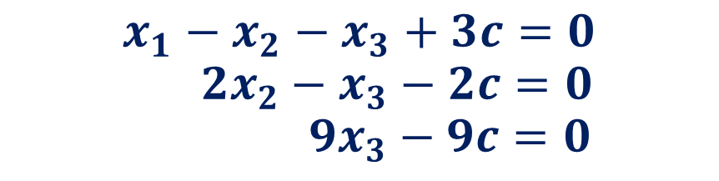
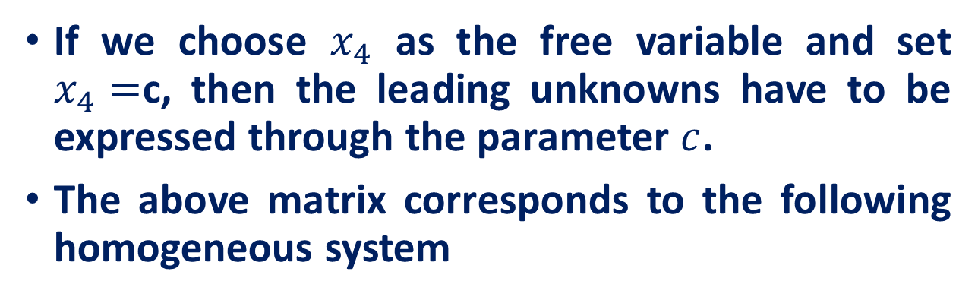
Homogenous system of linear equations: non-trivial Solution
$$x_{1}−x_{2}−x_{3}+3x_{4}=0$$
$$x_{1}+x_{2}−{2x}_{3}+x_{4}=0$$
$${4x}_{1}−{2x}_{2}+4x_{3}+x_{4}=0$$
$$\left[\begin{matrix}1 & −1 & −1 & 3 \\ 0 & 2 & −1 & −2 \\ 0 & 0 & 9 & −9\end{matrix}\right]$$
If we choose $x_{4}$ as the free variable and set $x_{4}=$c, then the leading unknowns have to be expressed through the parameter $c$.
The above matrix corresponds to the following homogeneous system
$$x_{1}−x_{2}−x_{3}+3c=0$$
$$2x_{2}−x_{3}−2c=0$$
$$9x_{3}−9c=0$$

Slide 20
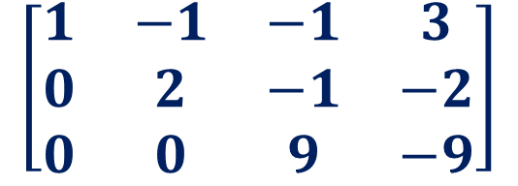
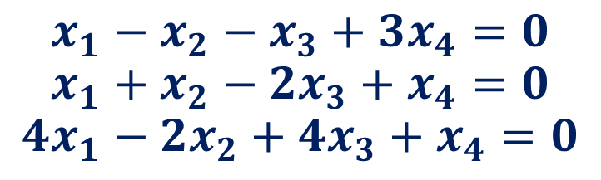
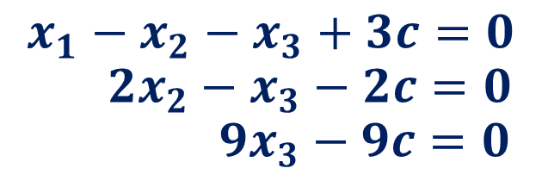
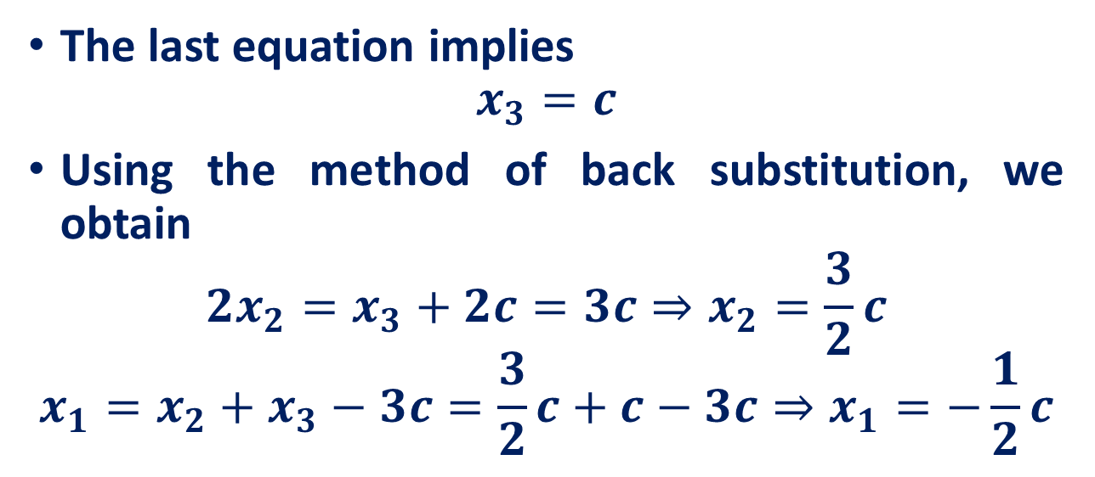
Homogenous system of linear equations: non-trivial Solution
$$x_{1}−x_{2}−x_{3}+3x_{4}=0$$
$$x_{1}+x_{2}−{2x}_{3}+x_{4}=0$$
$${4x}_{1}−{2x}_{2}+4x_{3}+x_{4}=0$$
$$\left[\begin{matrix}1 & −1 & −1 & 3 \\ 0 & 2 & −1 & −2 \\ 0 & 0 & 9 & −9\end{matrix}\right]$$
$$x_{1}−x_{2}−x_{3}+3c=0$$
$$2x_{2}−x_{3}−2c=0$$
$$9x_{3}−9c=0$$
The last equation implies
$$x_{3}=c$$
Using the method of back substitution, we obtain
$$2x_{2}=x_{3}+2c=3c⇒x_{2}=\frac{3}{2}c$$
$$x_{1}=x_{2}+x_{3}−3c=\frac{3}{2}c+c−3c⇒x_{1}=−\frac{1}{2}c$$

Slide 21

Homogenous system of linear equations: non-trivial Solution
$$x_{1}−x_{2}−x_{3}+3x_{4}=0$$
$$x_{1}+x_{2}−{2x}_{3}+x_{4}=0$$
$${4x}_{1}−{2x}_{2}+4x_{3}+x_{4}=0$$
$$\left[\begin{matrix}1 & −1 & −1 & 3 \\ 0 & 2 & −1 & −2 \\ 0 & 0 & 9 & −9\end{matrix}\right]$$
$$x_{1}−x_{2}−x_{3}+3c=0$$
$$2x_{2}−x_{3}−2c=0$$
$$9x_{3}−9c=0$$
$$X=\left[\begin{matrix}−\frac{1}{2}c \\ \begin{aligned} \frac{3}{2}c \\ c \\ c\end{aligned}\end{matrix}\right]=c\left[\begin{matrix}−\frac{1}{2} \\ \begin{aligned} \frac{3}{2} \\ 1 \\ 1\end{aligned}\end{matrix}\right]$$

Slide 22
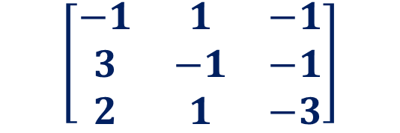
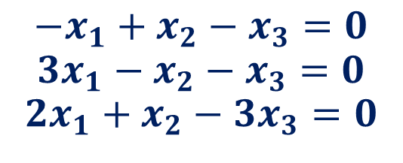
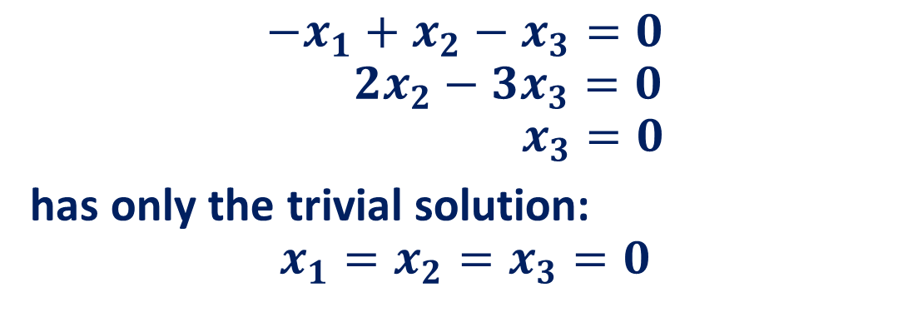
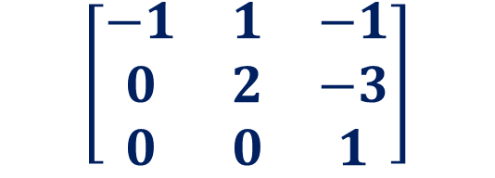
Homogenous system of linear equations: Trivial Solution
$${−x}_{1}+x_{2}−x_{3}=0$$
$${3x}_{1}−x_{2}−x_{3}=0$$
$${2x}_{1}+x_{2}−3x_{3}=0$$
$$\left[\begin{matrix}−1 & 1 & −1 \\ 3 & −1 & −1 \\ 2 & 1 & −3\end{matrix}\right]$$
$$\left[\begin{matrix}−1 & 1 & −1 \\ 0 & 2 & −3 \\ 0 & 0 & 1\end{matrix}\right]$$
The rank of this matrix equals 3. Therefore, there are no free variables and the system
$${−x}_{1}+x_{2}−x_{3}=0$$
$$2x_{2}−{3x}_{3}=0$$
$$x_{3}=0$$
has only the trivial solution:
$$x_{1}=x_{2}=x_{3}=0$$

Slide 23
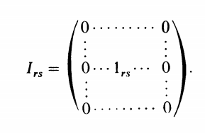
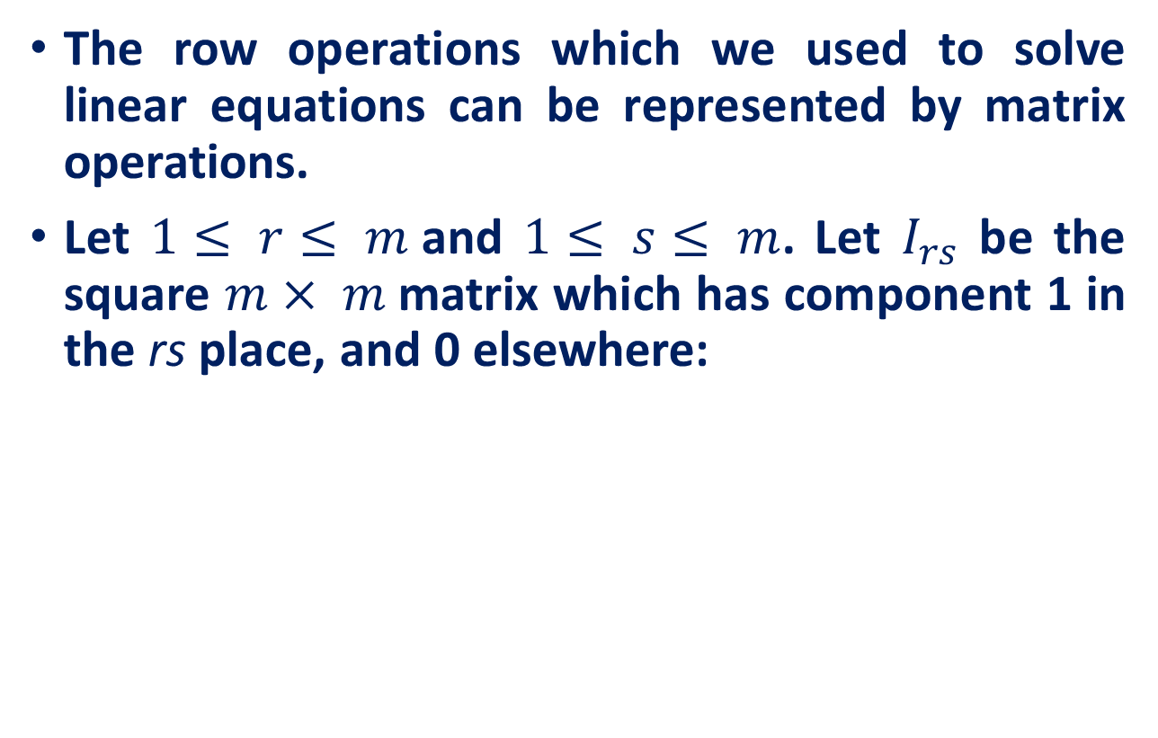
Tips for efficient implementation
The row operations which we used to solve linear equations can be represented by matrix operations.
Let $1≤ r≤ m$and $1≤ s≤ m$. Let $I_{rs}$ be the square $m× m$matrix which has component 1 in the rs place, and 0 elsewhere:

Slide 24
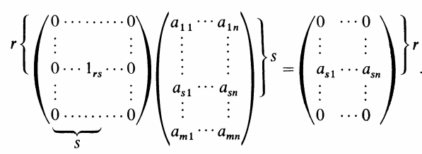
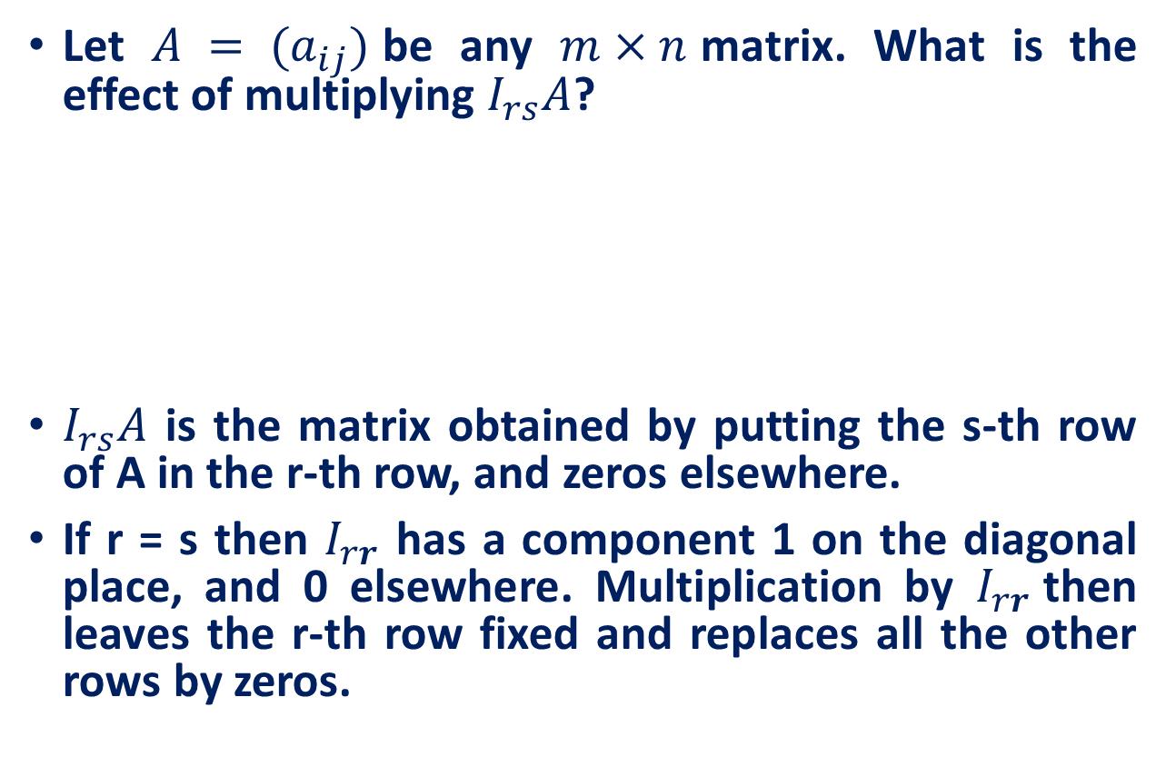
Tips for efficient implementation
Let $A = (a_{ij})$be any $m×n$matrix. What is the effect of multiplying $I_{rs}A$?
$I_{rs}A$ is the matrix obtained by putting the s-th row of A in the r-th row, and zeros elsewhere.
If r = s then $I_{rr}$ has a component 1 on the diagonal place, and 0 elsewhere. Multiplication by $I_{rr}$then leaves the r-th row fixed and replaces all the other rows by zeros.

Slide 25
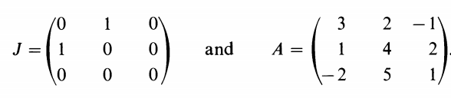
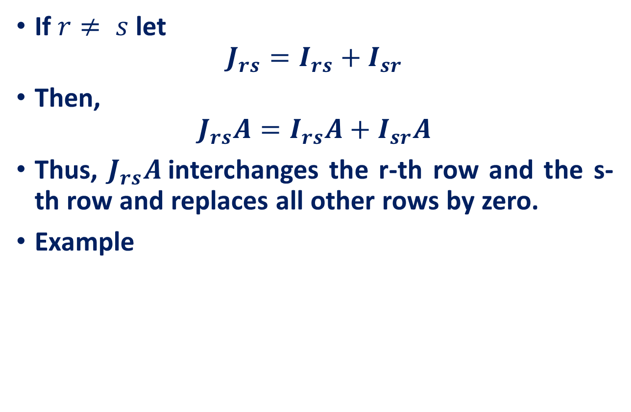
Tips for efficient implementation
If $r≠ s$let
$$J_{rs}=I_{rs}+I_{sr}$$
Then,
$$J_{rs}A=I_{rs}A+I_{sr}A$$
Thus, $J_{rs}A$interchanges the r-th row and the s-th row and replaces all other rows by zero.
Example

Slide 26
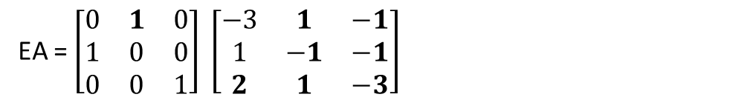

Tips for efficient implementation
let
$E=I_{12}+{I_{21}+I}_{33}$ and $A=\left[\begin{matrix}−1 & 1 & −1 \\ 3 & −1 & −1 \\ 2 & 1 & −3\end{matrix}\right]$
Question: What will be result of EA?
EA = $\left[\begin{matrix}0 & 1 & 0 \\ 1 & 0 & 0 \\ 0 & 0 & 1\end{matrix}\right] \left[\begin{matrix}−3 & 1 & −1 \\ 1 & −1 & −1 \\ 2 & 1 & −3\end{matrix}\right]$
First two rows of A will be interchanged

Slide 27
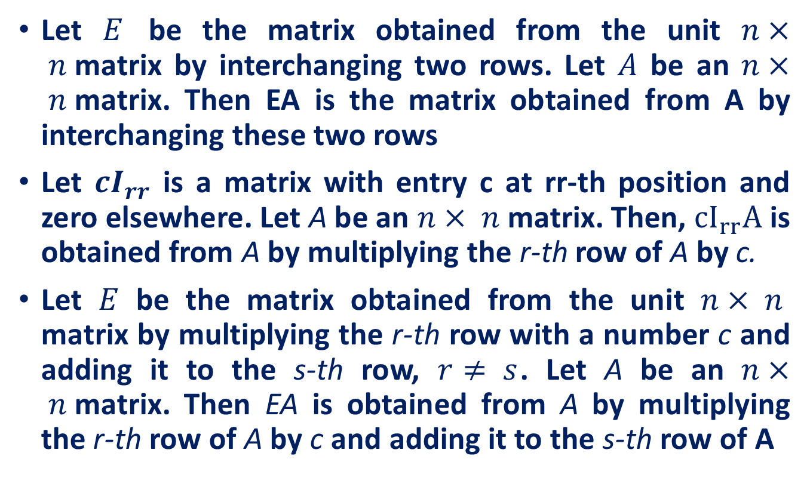
Tips for efficient implementation
Let $E$ be the matrix obtained from the unit $n× n$matrix by interchanging two rows. Let $A$ be an $n× n$matrix. Then EA is the matrix obtained from A by interchanging these two rows
Let ${cI}_{rr}$ is a matrix with entry c at rr-th position and zero elsewhere. Let A be an $n× n$matrix. Then, ${cI}_{rr}A$ is obtained from A by multiplying the r-th row of A by c.
Let $E$ be the matrix obtained from the unit $n× n$ matrix by multiplying the r-th row with a number c and adding it to the s-th row, $r≠ s$. Let A be an $n× n$matrix. Then EA is obtained from A by multiplying the r-th row of A by c and adding it to the s-th row of A
Interchange any two rows.
Replace any row by a nonzero constant multiple of itself.
Replace any row by the sum of that row and a constant multiple of any other row.

Slide 28
Matrix Inverse using Elementary Row Operations
Let A be the matrix

Slide 29
Inverse of a 3 x 3 Matrix
We begin with the 3 x 6 matrix whose left half is A and whose right half is the identity matrix.
We then transform the left half of this new matrix into the identity matrix— using sequence of elementary row operations on the entire new matrix.

Slide 30
Inverse of a 3 x 3 Matrix

Slide 31

Inverse of a 3 x 3 Matrix

Slide 32
Inverse of a 3 x 3 Matrix
We have now transformed the left half of this matrix into an identity matrix.
This means we’ve put the entire matrix in reduced row-echelon form.
The right half is now A^{–1}.

Slide 33








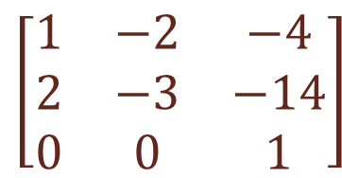




Matrix Inverse using Row Elementary Operation
A square matrix A is invertible if and only if A is row equivalent to the unit matrix. Any upper triangular matrix with nonzero diagonal elements is invertible.
A matrix B is row equivalent to a matrix A if B result from A via elementary row operations.
$$A=\left[\begin{matrix}1 & −2 & −4 \\ 2 & −3 & −6 \\ −3 & 6 & 15\end{matrix}\right]$$
$$I=\left[\begin{matrix}1 & 0 & 0 \\ 0 & 1 & 0 \\ 0 & 0 & 1\end{matrix}\right]$$
$$R_{1}=R_{1}−2R_{2}$$
$$\left[\begin{matrix}1 & −2 & −4 \\ 0 & 1 & −6 \\ 0 & 0 & 1\end{matrix}\right]$$
$$R_{1}=R_{1}−4R_{3}$$
$$R_{2}=R_{2}+2R_{1}$$
$$R_{3}=R_{3}−3R_{1}$$
$$\left[\begin{matrix}1 & −2 & −4 \\ 2 & −3 & −6 \\ −3 & 6 & 15\end{matrix}\right]$$
$$\left[\begin{matrix}1 & −2 & −4 \\ 2 & −3 & −6 \\ 0 & 0 & 3\end{matrix}\right]$$
$$\left[\begin{matrix}1 & −2 & −4 \\ 2 & −3 & −6 \\ 0 & 0 & 1\end{matrix}\right]$$
$$\left[\begin{matrix}1 & −2 & −4 \\ 2 & −3 & −14 \\ 0 & 0 & 1\end{matrix}\right]$$
$$R_{3}={3R}_{3}$$
$$R_{2}=R_{2}+8R_{3}$$

Slide 34

System of linear equations
Let $AX = B$be a system of n linear equations in n unknowns. Assume that the matrix of coefficients $A$ is invertible. Then there is a unique solution X to the system, and
$$X=A^{−1}B$$

Slide 35
Reference
Introduction to Linear Algebra, Mark Goldman, Emily Mackevicius
Lecture Notes on Linear Algebra, Arbind K Lal, Sukant Pati
Lecture notes on linear algebra, David Lerner
6502 : Mathematics for Engineers 2, James Burnett, Department of Mathematics, University College London
ENGG2013, Advanced Engineering Math. Kenneth Shum
Matrices and Determinants – 2, Carrer launcher
http://www.shsu.edu/ldg005/data/mth199/chapter5.ppt

